Slide 1
IB English Language and Literature
6 ELL SL 4
2019 - 2020
Shape of the Week (3):
Lesson 1: Gender in Advertising/ Goffman’s Theory
Lesson 2: Goffman’s Theory and Semiotic Analysis

Slide 2
Lesson 1: Gender in Advertising/ Goffman’s Theory
☑ Review connotation/ denotation, signifier/ signified
☑ Intro to Goffman’s Theory
☑ Self- correct Advertising HW
☑ Update

Slide 3

ASSESSMENT TERM 1
School (Report SA)
☑ Paper 1 Commentary [EXAM Rubric] Week 4 50%
☑ Mock Group FOA Week 6 50%
IB Assessment
☑ IB FOA 2: Gender in Ads Proposal due week 6, FOA given week 1&2 term 2
☑ IB WT 2: Speeches/ Letters, First Draft Proposal Week 10, finished proposal week 1.

Slide 4

Homework
No HW

Slide 5

How to read the signs and signifiers within a Media Text
All media texts have 2 layers of meaning:
DENOTATIVE LEVEL: What we actually see
CONNOTATIVE LEVEL: What you associate with this image

Slide 6
Denotation & Connotation
Denotative: The surface meaning
Connotative: The deeper or hidden meanings and associations

Slide 7
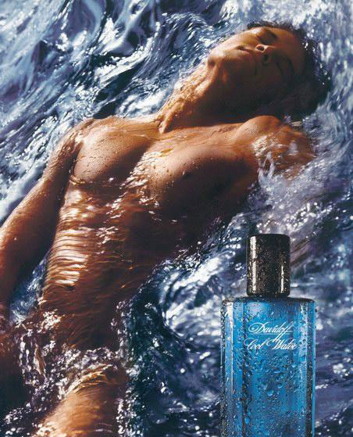
SIGNIFIER: Water/Ocean Wave
SIGNIFIES:
Wild, Stormy, Natural, Earthly
SIGNIFIER:
Facial Expression/Body Language
SIGNIFIES:
Ecstatic, pleasure lost in ecstacy, laid back, inviting
SIGNIFIER:
Mans Naked Torso
SIGNIFIES:
Natural, angelic, pure, toned, ideal, masculine, adonis
SIGNIFIER: Words ‘Cool Water’
SIGNIFIES:
Refreshing, different,
SIGNIFIER: Droplets on Bottle
SIGNIFIES:
Cool, chilled appearance, almost drinkable
SIGNIFIER: Calligraphy Style Font
SIGNIFIES:
Classic, timeless, expensive tastes

Slide 8
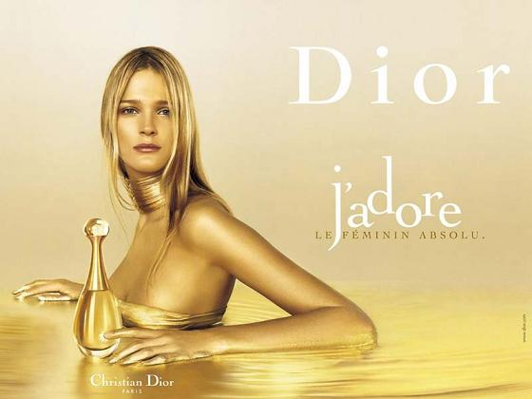
SIGNIFIER: Blonde Hair
Signifies:
Ideal Woman, Innocence, Looks ‘gold’
SIGNIFIER: Jewellery
Signifies:
Extravagance, Excess, Glamour, Decedance
SIGNIFIER: Font
Signifies:
Dior Logo, Brand Name, Designer
SIGNIFIER: Word ‘Love’
Signifies:
Passion, Excitement, Lust
SIGNIFIER: Colour Gold
Signifies:
Luxury, Riches, Expense, Success, Shimmering
SIGNIFIER: Perfume Bottle
Signifies: Looks Jewel-like, Buried Treasure

Slide 9
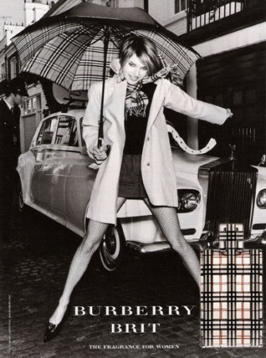
TASK
A
Highlight:
A) The key signifiers
B) Their connotative meaning

Slide 10
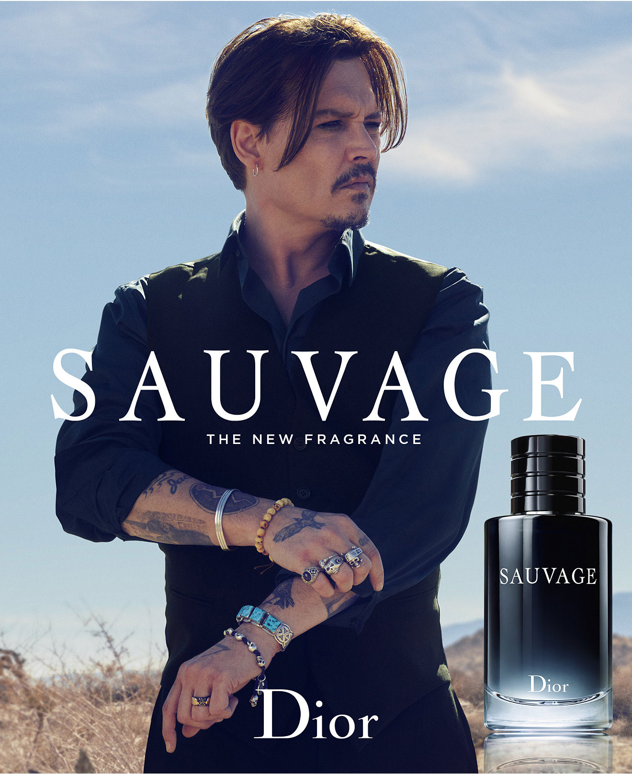
B
Highlight:
A) The key signifiers
B) Their connotative meaning

Slide 11
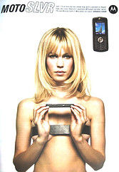
Slide Show
Gender Representations in Advertising
Goffmans Theory (1972)

Slide 12
In the portrayal of men and women, advertising often uses the following codes and conventions:
Superiority, Domination & Body Language: Men are shown in dominant positions and appear to be reflective of thought and intelligence. Women are physically portrayed in sexual or reclining poses with blank or inviting expressions.
Dismemberment: On females, parts of the body such as legs, chest, etc., are used, rather than the full body. This is often applied to sell products which are not related to the body, such as mobile phones (right)
The Voice-Over Authority: In moving image advertisements, male voices are used as voice-over's in commercials rather than females.

Slide 13
Advertisement
German Coast Guard | https://www.youtube.com/watch?v=O7_s8JRiQqU&gl=SG&hl=en-GB
Embrace Life | https://www.youtube.com/watch?v=h-8PBx7isoM
MTV Global Warming | https://www.youtube.com/watch?v=AhxZSs8aMNE
Party All Night | https://www.youtube.com/watch?v=FHDKHKixKdY

Slide 14
Advertisement | What kinds of advertising techniques are used and to what effects?
German Coast Guard | Humor - This ad relies heavily on humor. The joke lies in the misunderstanding between the coast guard man and the sailor aboard the 'sinking' boat. Humor makes the ad memorable. Problem / benefit - This ad shows what kinds of problems can arise when people do not understand each other. Learning English is the solution to this problem.
Embrace Life | Fear - The expressions on the child and mother's face are scared, as they watch their father crash is make-believe car. They scare the audience into wearing their seatbelt. Problem / benefit - If you want to prevent your loved ones from getting hurt or killed in a car accident, encourage them to buckle up. The benefit is that you keep your loved one.

Slide 15
MTV global warming ad | Fear - The ad scares us about the consequences of global warming. Planet Earth is at first very pristine but eventually very polluted.
Party All Night | Fear - This ad uses fear to warn young adults about the effects of cocaine. We see the girl deteriorating throughout the evening, ending up at the wrong places with the wrong people Testimonial - The ad follows one girl. It is her story, which is meant to convince us to stay off drugs.

Slide 16
Pro-Aging | Anti-advertising - The copy reads: 'Too old to be in an ad'. Ironically this is an ad and older women are in it. This Dove ad comments on the false reality that advertisers present to the public and targets a demographic group that is rarely targeted by ads: older women.
UnHate | Shock - The sight of men kissing and Muslim women kissing is very shocking for a lot of people. Conflict - There are physical conflicts in this film that catch our attention and startle the audience. These are resolved, as we have a tendency to want to see conflicts resolved. Bandwagon effect - Everyone seems to be joining in the celebration of love. People begin kissing and dancing. This joy seems to be contagious.

Slide 17
Homework
Reading: Goffman’s Theory docs on Managebac.

Slide 18
IB English Language and Literature
6 ELL SL 4
2019 - 2020
Shape of the Week (3):
Lesson 1: Gender in Advertising/ Goffman’s Theory
Lesson 2: Goffman’s Theory and Semiotic Analysis

Slide 19
Lesson 2: Goffman’s Theory and Semiotic Analysis
☑ Apply Goffman’s theory to semiotic analysis
☑ Presentations

Slide 20
ASSESSMENT TERM 1
School (Report SA)
☑ Paper 1 Commentary [EXAM Rubric] Week 4 50%
☑ Mock Group FOA Week 6 50%
IB Assessment
☑ IB FOA 2: Gender in Ads Proposal due week 6, FOA given week 1&2 term 2
☑ IB WT 2: Speeches/ Letters, First Draft Proposal Week 10, finished proposal week 1.

Slide 21
Homework
Reading: Goffman’s Theory docs on Managebac.

Slide 22
ASSIGNMENT:
Carry out a Semiotic Analysis of assigned advertisement commenting on the relevant headings listed below:
1. SYMBOLIC & WRITTEN SIGNIFIERS
Lighting & Colours
Positioning of Words & Images
Setting & Locations
Facial Expressions & Body Language (of people)
Typeface/Font Style
Key (Main) Images/Signifiers
Clothing, Hair & Make Up
2. Goffman’s Theory
Does the advert adhere to Goffman’s gender theory? Comment on the representation of men/women featured within the advert?

Slide 23
B

Slide 24
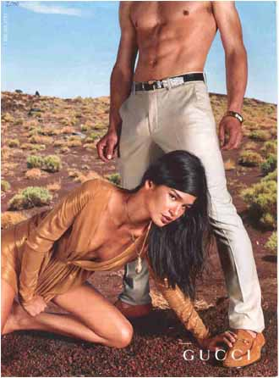
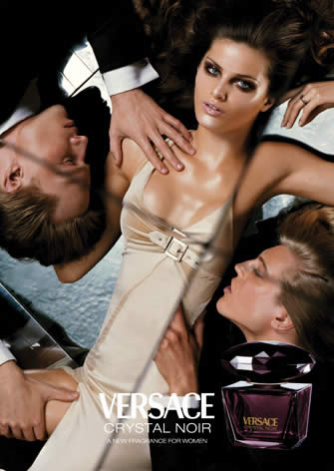
A
B

Slide 25
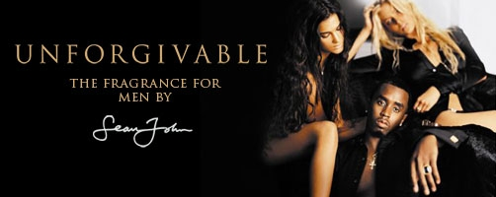

Slide 26
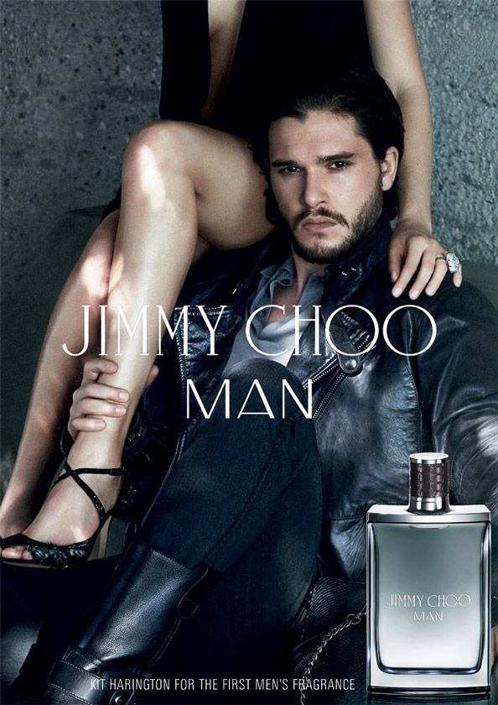

Slide 27
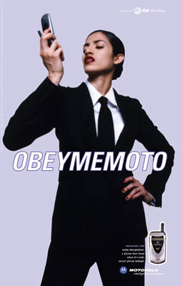

Slide 28
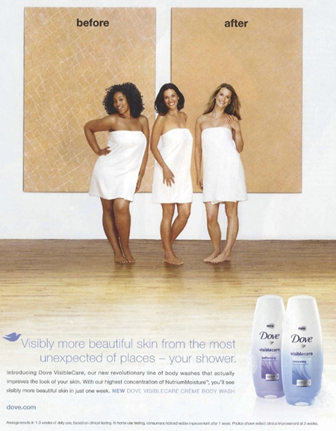

Slide 29
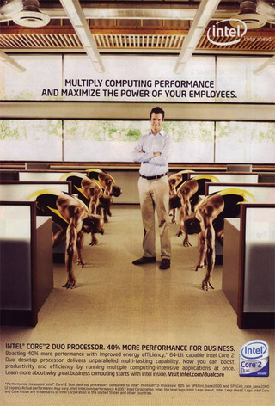

Slide 30
Homework
Reading:
1984 and Chronicles
You need to be familiar with these enough to quote and paraphrase in exam conditions!
FOA prep:
find your ad

